Slide 1
G5 Print Settings Case studies
陈剑达
2021年11月18日

Slide 2
耗材介绍一
PA6
Nylon 6, also known as PA6, polyamide 6, nylon 6, is a polymer compound. The chemical and physical properties of nylon 6 are very similar to nylon 66, however, it has a lower melting point and a wide processing temperature range. It has better impact and dissolution resistance than nylon 66 plastic, but is also more hygroscopic. Because many quality characteristics of plastic parts are affected by hygroscopicity, it is important to take this into account when designing products using nylon 6. In order to improve the mechanical properties of nylon 6, various modifiers are often added. Glass fiber is the most common additive, and sometimes synthetic rubber, such as EPDM and SBR, is added to improve impact resistance. For products without additives, the shrinkage of nylon 6 plastic material is between 1% and 1.5%. Adding glass fiber additives can reduce the shrinkage to 0.3% (but slightly higher in the direction perpendicular to the process). The shrinkage of molding assembly is mainly affected by the crystallinity and hygroscopicity of the material. Actual shrinkage is also a function of part design, wall thickness and other process parameters. Nylon 6 injection drying treatment Since nylon 6 easily absorbs moisture, special attention should be paid to the drying before processing. If the material is supplied in waterproof packaging, the container should be kept tightly closed. If the humidity is greater than 0.2%, it is recommended to dry in hot air above 80°C for 16 hours. If the material has been exposed to air for more than 8 hours, vacuum drying at 105°C for more than 8 hours is recommended.

Slide 3
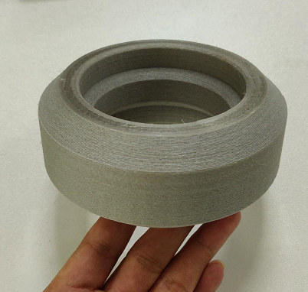
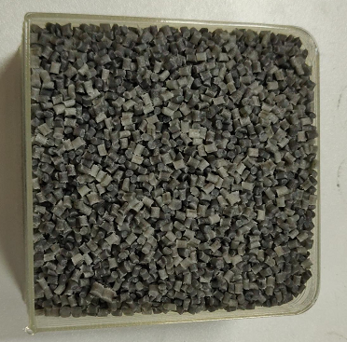
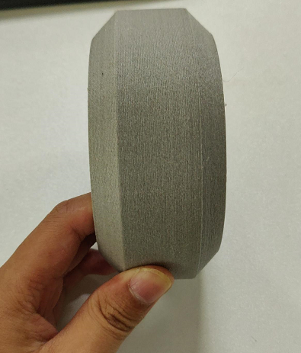
Case Study 1
G5-V Wheel - Printing Parameters
Printing material(G5-PA6-20) | main ingredient | PA6 | Test Date | 2021.9.26
 | Enhancer System | 20% glass fiber | Particle diameter | 2.5-3.0mm
Print temperature | Nozzle temperature | 260℃ | printing speed | 30mm/s
 | hot bed temperature | 65℃ | print layer height | 0.4mm
Model size | 120*120*51mm |  | Nozzle diameter | 1mm
Bottom plate material | Semi-tempered carbon crystalline silicon glass |  | Infill | 15%
Whether to use glue | Yes |  | Finished product | As shown on the right
Print environment | open
Actual print time | 4h30min
Finished product summary | The surface layer is neat, frosted texture, high strength and certain toughness

Slide 4
PS
Polystyrene (abbreviated PS) refers to a polymer synthesized by free radical addition polymerization of styrene monomer, and the chemical formula is (C8H8)n. It is a colorless and transparent thermoplastic with a glass transition temperature higher than 100°C, so it is often used to make various disposable containers that need to withstand the temperature of boiling water, as well as disposable foam lunch boxes. The glass transition temperature of polystyrene is 80～105℃, the amorphous density is 1.04～1.06g/cm3, the crystal density is 1.11～1.12g/cm3, the melting temperature is 240℃, and the resistivity is 1020～1022Ω·cm. Thermal conductivity 0.116 watts/(m·K) at 30°C. Usually polystyrene is an amorphous random polymer, which has excellent heat insulation, insulation and transparency. The long-term use temperature is 0-70 ° C, but it is brittle and easy to crack at low temperature. There are also isotactic and syndiotactic and atactic polystyrene. Isotactic polymers are highly crystalline, and syndiotactic polymers are partially crystalline.

Slide 5
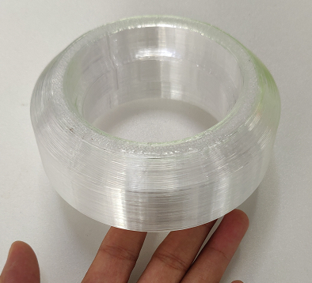
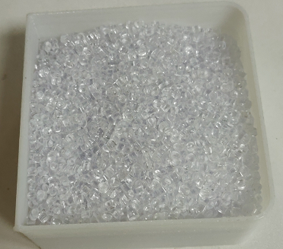
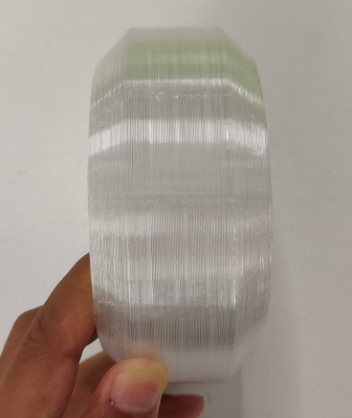
打印案例一
G5-V轮-打印参数
打印材料 （G5-GPPS） | main ingredient | GPPS | Test Date | 2021.10.8
 | Enhancer System | none | Particle diameter | 3.0-4.0mm
Print temperature | Nozzle temperature | 240℃ | printing speed | 38mm/s
 | hot bed temperature | 100℃ | print layer height | 0.4mm
Model size | 120*120*51mm |  | Nozzle diameter | 1mm
Bottom plate material | aluminum plate |  | Infill | 15%
Whether to use glue | Yes |  | Finished product | 如右图所示
Print environment | cooler box
Actual print time | 3h
Finished product summary | The surface layer is neat, the hardness is high but very brittle, it needs to be printed in a thermal environment, otherwise the layers will break

Slide 6
耗材介绍三
PP
Polypropylene, abbreviated as PP, is a colorless, odorless, non-toxic, translucent solid substance. Polypropylene is a thermoplastic synthetic resin with excellent properties, which is a colorless and translucent thermoplastic lightweight general-purpose plastic. It has chemical resistance, heat resistance, electrical insulation, high-strength mechanical properties and good high wear-resistant processing properties, etc., which makes polypropylene rapidly used in machinery, automobiles, electronic appliances, construction, textiles, packaging since its inception. It has been widely developed and applied in many fields such as agriculture, forestry, fishery and food industry. In recent years, with the rapid development of my country's packaging, electronics, automobile and other industries, it has greatly promoted the development of my country's industry. And because of its plasticity, polypropylene materials are gradually replacing wooden products, and high strength, toughness and high wear resistance have gradually replaced the mechanical functions of metals. In addition, polypropylene has good grafting and compounding functions, and has huge application space in concrete, textile, packaging and agriculture, forestry and fishery.

Slide 7
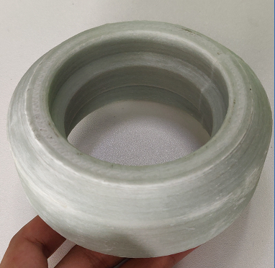
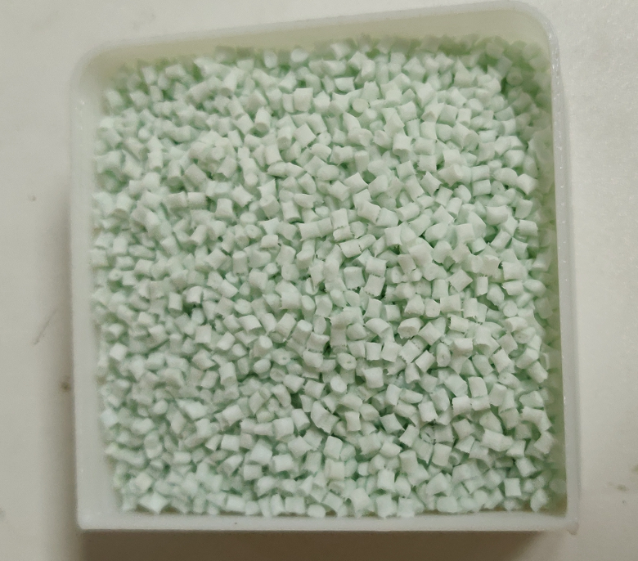
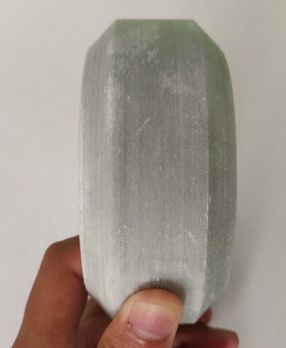
打印案例一
G5-V轮-打印参数
打印材料 (G5-PP-30) | main ingredient | PP | Test Date | 2021.9.27
 | Enhancer System | 30% glassfiber | Particle diameter | 2.0-3.0mm
Print temperature | Nozzle temperature | 230℃ | printing speed | 30mm/s
 | hot bed temperature | 80℃ | print layer height | 0.4mm
Model size | 120*120*51mm |  | Nozzle diameter | 1mm
Bottom plate material | Semi-tempered carbon crystalline silicon glass |  | Infill | 15%
Whether to use glue | Yes |  | Finished product | 如右图所示
Print environment | open
Actual print time | 4h30min
Finished product summary | The surface layer is neat, but the hand feel is rough and the strength is high. It is recommended to print in an incubator when printing larger models.

Slide 8
耗材介绍四
TPE
Thermoplastic elastomer, referred to as TPE or TPR, is the abbreviation of Thermoplastic rubber. It is a kind of elastomer that has the elasticity of rubber at room temperature and can be plasticized at high temperature. The structural feature of thermoplastic elastomers is that different resin segments and rubber segments are composed of chemical bonds. The resin segment forms physical cross-linking points by virtue of interchain force, and the rubber segment is a highly elastic segment that contributes to elasticity. The physical crosslinking of the plastic segments is reversible with temperature, showing the plastic processing properties of thermoplastic elastomers. Therefore, thermoplastic elastomer has the physical and mechanical properties of vulcanized rubber and the processing properties of thermoplastics. It is a new type of polymer material between rubber and resin, and is often referred to as the third-generation rubber. Thermoplastic elastomer is a new type of polymer material between rubber and resin, which can not only replace part of rubber, but also modify plastic. Thermoplastic elastomers have the dual properties and broad characteristics of rubber and plastic, so that they are widely used in the rubber industry to manufacture rubber shoes, tapes and other daily necessities and rubber hoses, tapes, rubber strips, rubber sheets, plastic parts and adhesives, etc. Various industrial supplies. At the same time, thermoplastic elastomers can also be widely used in the modification of general thermoplastic resins such as PVC, PE, PP, PS, and even engineering plastics such as PU, PA, and CA, instead of rubber, which has brought a new situation to the plastics industry.

Slide 9
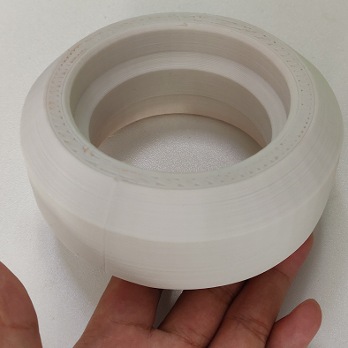
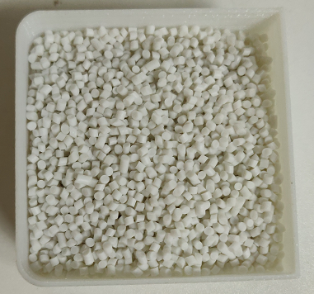
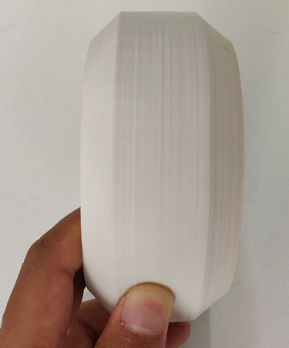
G5-V Wheel - Printing Parameters
打印材料 (G5-TPE) | main ingredient | TPE | Test Date | 2021.9.28
 | Enhancer System | 无 | Particle diameter | 2.0-3.0mm
Print temperature | Nozzle temperature | 220℃ | printing speed | 30mm/s
 | hot bed temperature | 80℃ | print layer height | 0.4mm
Model size | 120*120*51mm |  | Nozzle diameter | 1mm
Bottom plate material | Semi-tempered carbon crystalline silicon glass |  | Infill | 15%
Whether to use glue | 是 |  | Finished product | 如右图所示
Print environment | 敞开
Actual print time | 4h30min
Finished product summary | The surface texture is relatively neat, rubber feel, high toughness, and elasticity. It is recommended to print in an incubator when printing larger models.

Slide 10
耗材介绍五
TPV
Thermoplastic vulcanizate (English as Thermoplastic Vulcanizate), referred to as TPV, thermoplastic vulcanizate in Chinese referred to as thermoplastic rubber (English Thermoplastic Rubber), referred to as TPR, but this name is easy to be confused with other types of thermoplastic elastomers (Thermoplastic Elastomer in English) Together, because thermoplastic elastomers are usually called thermoplastic rubbers, especially styrene elastomers, at least in China, it seems that "TPR" has become its proper name. When it comes to TPR, it refers to SBS, SEBS, etc. Styrenic elastomers are thermoplastic elastomers as base materials, which are inseparable from the large consumption of styrenic elastomers in the fields of civil and final consumer goods. TPV is mainly composed of two parts, one is plastic as a continuous phase, and the other is rubber as a dispersed phase. Usually rubber needs to be combined with softening oil or plasticizer. Vulcanizing agent and some auxiliary additives are also essential. In addition, some inorganic fillers will be added in order to reduce costs or improve performance in certain aspects.

Slide 11
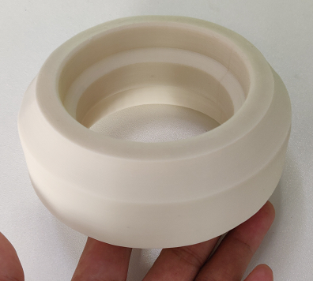
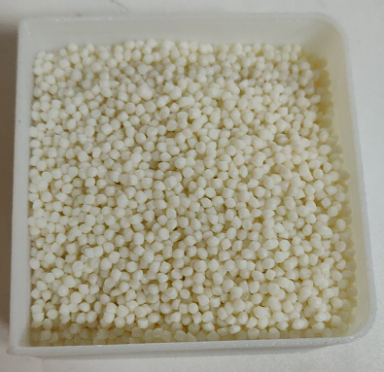
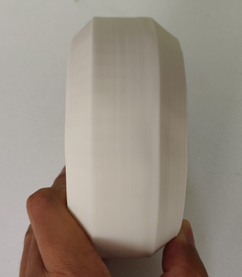
G5-V Wheel - Printing Parameters
打印材料 (G5-TPV) | main ingredient | TPV | Test Date | 2021.9.28
 | Enhancer System | none | Particle diameter | 2.0-3.0mm
Print temperature | Nozzle temperature | 220℃ | printing speed | 30mm/s
 | hot bed temperature | 80℃ | print layer height | 0.4mm
Model size | 120*120*51mm |  | Nozzle diameter | 1mm
Bottom plate material | Semi-tempered carbon crystalline silicon glass |  | Infill | 15%
Whether to use glue | Yes |  | Finished product | 如右图所示
Print environment | 敞开
Actual print time | 4h30min
Finished product summary | The surface has neat texture, rubber feel, high toughness and elasticity. It is recommended to print in an incubator when printing larger models.

Slide 12
耗材介绍六
PLA
Polylactic acid, also known as polylactide, is a polyester polymer obtained by polymerizing lactic acid as the main raw material. It is a new type of biodegradable material. Polylactic acid has good thermal stability, the processing temperature is 170-230 °C, and it has good solvent resistance. It can be processed in various ways, such as extrusion, spinning, biaxial stretching, and injection blow molding. In addition to being biodegradable, products made of polylactic acid have good biocompatibility, gloss, transparency, hand feel and heat resistance.

Slide 13
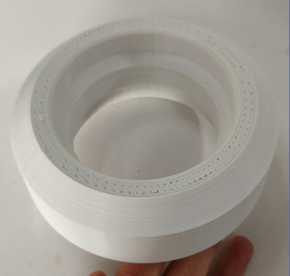
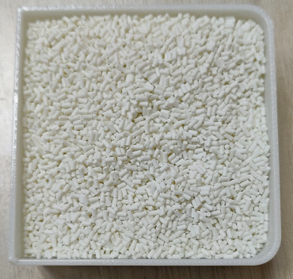
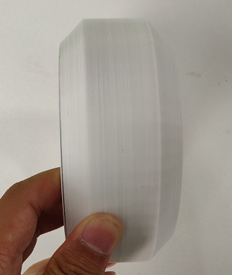
打印案例一
G5-V轮-打印参数
打印材料 (G5-PLA-White) | main ingredient | PLA | Test Date | 2021.9.28
 | Enhancer System | none | Particle diameter | 2.0-3.0mm
Print temperature | Nozzle temperature | 200℃ | printing speed | 60mm/s
 | hot bed temperature | 60℃ | print layer height | 0.4mm
Model size | 120*120*51mm |  | Nozzle diameter | 1mm
Bottom plate material | Semi-tempered carbon crystalline silicon glass |  | Infill | 15%
Whether to use glue | no |  | Finished product | As shown on the right
Print environment | open
Actual print time | 2h19min
Finished product summary | The surface layer is neat, the line is uniform, and it is easy to print

Slide 14
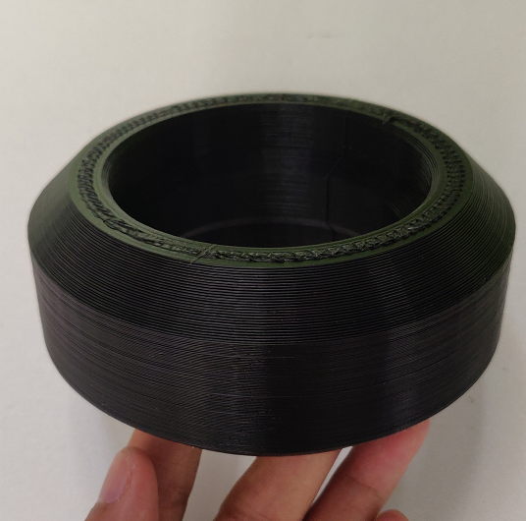
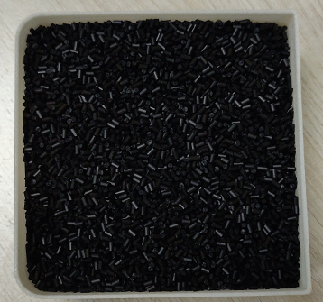
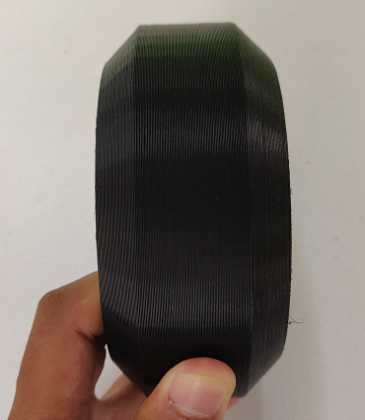
打印案例二
G5-V轮-打印参数
打印材料 (G5-PLA-高碳) | main ingredient | PLA | Test Date | 2021.9.28
 | Enhancer System | 无 | Particle diameter | 2.0-3.0mm
Print temperature | Nozzle temperature | 200℃ | printing speed | 60mm/s
 | hot bed temperature | 60℃ | print layer height | 0.4mm
Model size | 120*120*51mm |  | Nozzle diameter | 1mm
Bottom plate material | 半钢化碳晶硅玻璃 |  | Infill | 15%
Whether to use glue | 否 |  | Finished product | 如右图所示
Print environment | 敞开
Actual print time | 2h19min
Finished product summary | 表面层纹工整、出线均匀、易打印

Slide 15
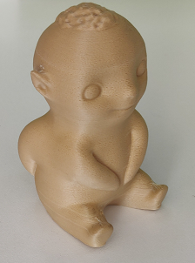
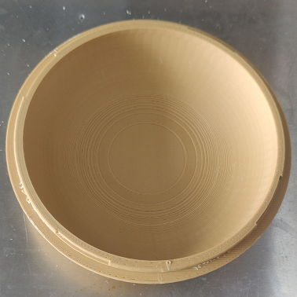
打印案例三
打印材料 (G5-PLA-wood plastic) | main ingredient | PLA | Test Date | 2021.10.20
 | Enhancer System | wood flour | Particle diameter | 2.0-3.0mm
Print temperature | Nozzle temperature | 180℃ | printing speed | 60mm/s
 | hot bed temperature | 60℃ | print layer height | 0.2mm
Model size | 155*155*40mm |  | Nozzle diameter | 0.6mm
Bottom plate material | Semi-tempered carbon crystalline silicon glass |  | Infill | 22%
Whether to use glue | yES |  | Finished product | 如右图所示
Print environment | open
Actual print time | 7h20min
Finished product summary | The surface texture is relatively neat, the thread outlet is uniform, and the temperature should not be too high during printing, otherwise it will be easy to be out of material

Slide 16
耗材介绍七
TPU
Thermoplastic polyurethane elastomer, also known as thermoplastic polyurethane rubber, referred to as TPU, is a (AB) n-type block linear polymer, A is polyester or polyether with high molecular weight (1000~6000), B is a linear polymer containing 2~12 A diol with chain carbon atoms, the chemical structure between the AB segments is a diisocyanate. Thermoplastic polyurethane rubber is cross-linked by intermolecular hydrogen bonds or lightly cross-linked between macromolecular chains. As the temperature increases or decreases, these two cross-linked structures are reversible. In the molten state or solution state, the intermolecular force weakens, and after cooling or solvent volatilization, there is a strong intermolecular force connecting together, restoring the performance of the original solid. Typical TPU such as spandex and so on. Thermoplastic polyurethane elastomer (TPU) is a kind of elastomer that can be plasticized by heating and dissolved by solvent. It has excellent comprehensive properties such as high strength, high toughness, wear resistance and oil resistance. It has good processing performance and is widely used in national defense, medical, Food and other industries.

Slide 17
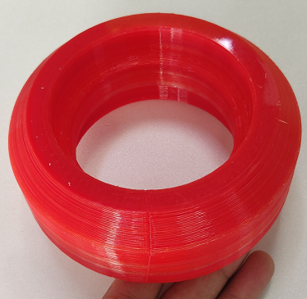
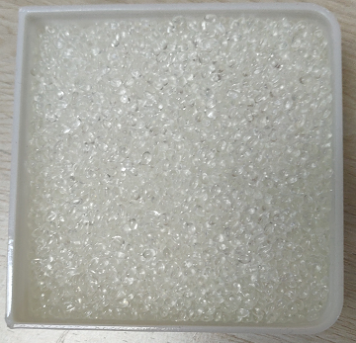
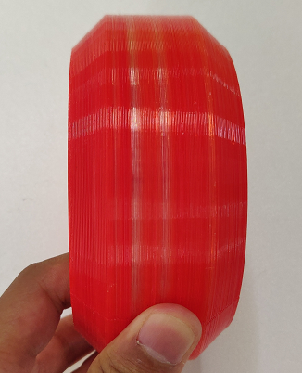
G5-V Wheel - Printing Parameters
printing material (G5-TPU) | main ingredient | TPU | Test Date | 2021.9.28
 | Enhancer System | none | Particle diameter | 2.0-3.0mm
Print temperature | Nozzle temperature | 220℃ | printing speed | 30mm/s
 | hot bed temperature | 80℃ | print layer height | 0.4mm
Model size | 120*120*51mm |  | Nozzle diameter | 1mm
Bottom plate material | Semi-tempered carbon crystalline silicon glass |  | Infill | 15%
Whether to use glue | Yes |  | Finished product | As shown on the right (added red masterbatch)
Print environment | open
Actual print time | 4h30min
Finished product summary | The surface layer is neat, the adhesion between layers is good, and it is easy to print

Slide 18
耗材介绍八
ABS
ABS plastic is a terpolymer of three monomers, acrylonitrile (A), butadiene (B) and styrene (S). The relative content of the three monomers can be changed arbitrarily to make various resins. ABS plastic has the common properties of three components, A makes it resistant to chemical corrosion, heat resistance, and has a certain surface hardness, B makes it have high elasticity and toughness, and S makes it have the processing and molding characteristics of thermoplastics and improve electrical properties. performance. Therefore, ABS plastic is a kind of "tough, hard and rigid" material with easily available raw materials, good comprehensive performance, low price and wide application. ABS plastic has been widely used in machinery, electrical, textile, automobile, aircraft, ship and other manufacturing industries and chemical industry.

Slide 19
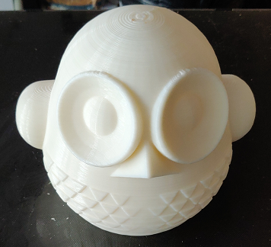
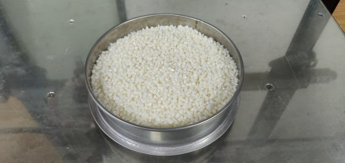
owl - print parameters
printing material(G5-ABS) | main ingredient | ABS | Test Date | 2021.9.28
 | Enhancer System | none | Particle diameter | 2.0-3.0mm
Print temperature | Nozzle temperature | 250℃ | printing speed | 50mm/s
 | hot bed temperature | 110℃ | print layer height | 0.4mm
Model size | 173*167*150mm |  | Nozzle diameter | 1.5mm
Bottom plate material | Semi-tempered carbon crystalline silicon glass |  | Infill | 25%
Whether to use glue | Yes |  | Finished product | 如右图所示
Print environment | Open FOR SMALL PARTS, CLOSED FOR LARGE PARTS
Actual print time | 7h30min
Finished product summary | The surface layer is neat, the adhesion between layers is good, and the edges are easy to warp. When printing large-scale models, it is recommended to print in a thermal insulation cover.

Slide 20
Consumables Introduction IX
PETG
PETG plastic is a kind of transparent plastic in short, it is an amorphous copolyester. The common comonomer of PETG is 1,4-cyclohexanedimethanol (CHDM), the full name is polyethylene terephthalate. Alcohol ester-1,4-cyclohexanedimethanol ester. PETG is an amorphous copolyester. With the increase of CHDM in the copolymer, the melting point decreases, the glass transition temperature increases, the crystallinity decreases, and finally an amorphous polymer is formed. Generally, the content of CHDM in PETG is 30%-40%. Has good viscosity, transparency, color, chemical resistance, and resistance to stress whitening. Quickly thermoformed or extrusion blow molded. Viscosity is better than acrylic (acrylic). Its products are highly transparent and have excellent impact resistance. It is especially suitable for forming thick-walled transparent products. Its processing and forming performance is excellent, and it can be designed in any shape according to the designer's intention. Traditional extrusion, injection molding, blow molding and suction can be used. Plastic and other molding methods，t can be widely used in the market of sheet material, high-performance shrink film, bottle and profile material, etc. At the same time, its secondary processing performance is excellent, and conventional machining can be carried out. PETG is an amorphous copolyester. Its products are highly transparent and have excellent impact resistance. It is especially suitable for forming thick-walled transparent products. Traditional molding methods such as extrusion, injection molding, blow molding and blister molding can be widely used in the market of sheet materials, high-performance shrink films, bottles and profiles, and cosmetic packaging. Regular machining finishes. The main domestic agents of Eastman PETG and other products currently have Shanghai Lianmo Chemical Co., Ltd.

Slide 21
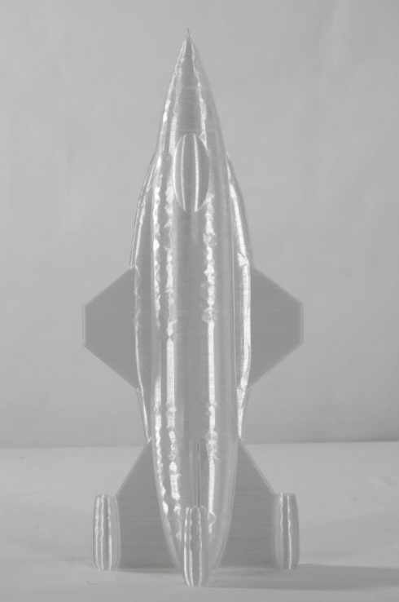
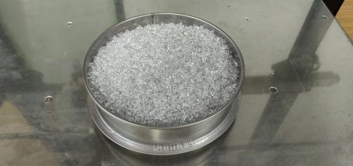
打印案例一
火箭-打印参数
打印材料 (G5-PETG) | main ingredient | PETG | Test Date | 2021.9.28
 | Enhancer System | 无 | Particle diameter | 2.0-3.0mm
Print temperature | Nozzle temperature | 230℃ | printing speed | 50mm/s
 | hot bed temperature | 90℃ | print layer height | 0.4mm
Model size | 204*120*500mm |  | Nozzle diameter | 1.5mm
Bottom plate material | 半钢化碳晶硅玻璃 |  | Infill | 0%（螺旋打印）
Whether to use glue | 是 |  | Finished product | 如右图所示
Print environment | 敞开
Actual print time | 5h
Finished product summary | 表面层纹工整、层与层之间的粘结力好、需要调整料筒散热风扇打印速度及温度之间达到一定平衡、打印难度中等

Slide 22
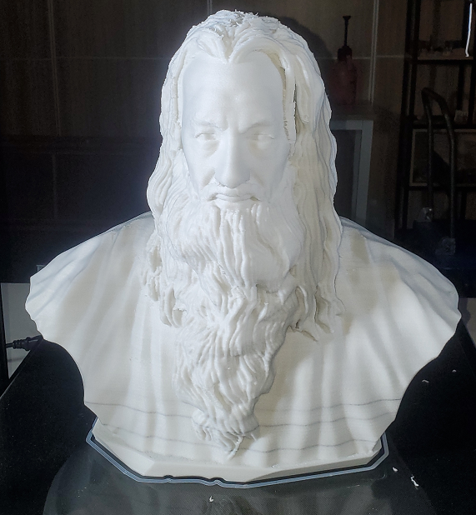
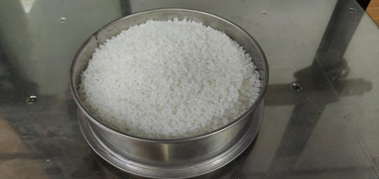
打印案例二
打印材料 (G5-PETG-10) | main ingredient | PETG | Test Date | 2021.9.28
 | Enhancer System | 10% glassfiber | Particle diameter | 2.0-3.0mm
Print temperature | Nozzle temperature | 250℃ | printing speed | 50mm/s
 | hot bed temperature | 100℃ | print layer height | 0.4mm
Model size | 480*253*450mm |  | Nozzle diameter | 1.5mm
Bottom plate material | Semi-tempered carbon crystalline silicon glass |  | Infill | 25%
Whether to use glue | Yes |  | Finished product | 如右图所示
Print environment | open |  | Test Date
Actual print time | 52h |  | Particle diameter
Finished product summary | The surface layer is neat, the adhesion between layers is good, and the edges are easy to warp. When printing large-scale models, it is recommended to print in a thermal insulation cover.

Slide 23
Introduction of consumables -10
15-5PH
15-5PH stainless steel, also known as precipitation hardening stainless steel, is a martensitic precipitation hardening stainless steel, with good processability, excellent mechanical properties, resistance to general corrosive environments, good strength, toughness and ductility, hardness and corrosion resistance. The same as 304 stainless steel it is good. 15-5PH may be used to treat or heat treat conditions to obtain various properties. Machining can be carried out under a variety of achievable conditions, however the H1150M has the best service life in this condition. Applications: Aerospace, aircraft parts, components manufacturing high pressure valves and other corrosive environments, grooves, fasteners, equipment and equipment. ●15-5PH chemical composition①: Carbon C: ≤0.07 Manganese Mn: ≤1.00 Silicon Si: ≤1.00 Chromium Cr: 14.0~15.5 Nickel Ni②: 3.5~5.5 Phosphorus P: ≤0.04 Sulfur S: ≤0.03 Copper Cu: 2.5~4.5 Niobium+Tantalum Nb+Ta: 0.15~0.45 Note: ①A single value is the highest value unless otherwise specified; ②When used in some pipe-making processes, the nickel content of some types of austenitic stainless steel must be slightly higher than the value shown in the table.

Slide 24
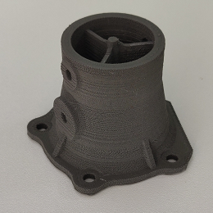
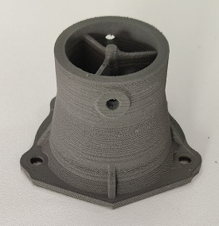
Print case one
Industrial Parts - Printing Parameters
printing material (G5-15-5PH) | main ingredient | 15-5PH | Test Date | 2021.11.16
 | Enhancer System |  | Particle diameter | 2.0-3.0mm
Print temperature | Nozzle temperature | 235℃ | printing speed | 25mm/s
 | hot bed temperature | 110℃ | print layer height | 0.2mm
Model size | 80*71*54.5mm |  | Nozzle diameter | 0.4mm
Bottom plate material | Semi-tempered carbon crystalline silicon glass |  | Infill | 100%
Whether to use glue | Yes |  | Finished product | 如右图所示
Print environment | cooler box
Actual print time | 8h
Finished product summary | The surface texture is slightly poor, the extrusion amount needs to be adjusted, and it is not easy to print

