Slide 1
Sharp printing curve production
Sharp print curve production

Slide 2
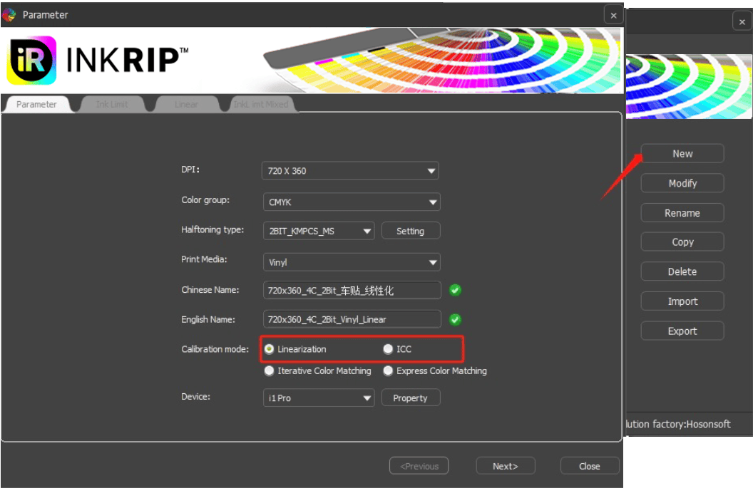
Sharp print curve production
1.1 Learity, chemical curve production
Upper left corner RIIN icon-Color Management
1. Click the sharp print icon in the upper left corner and select "color management" to enter the color management interface.

Slide 3
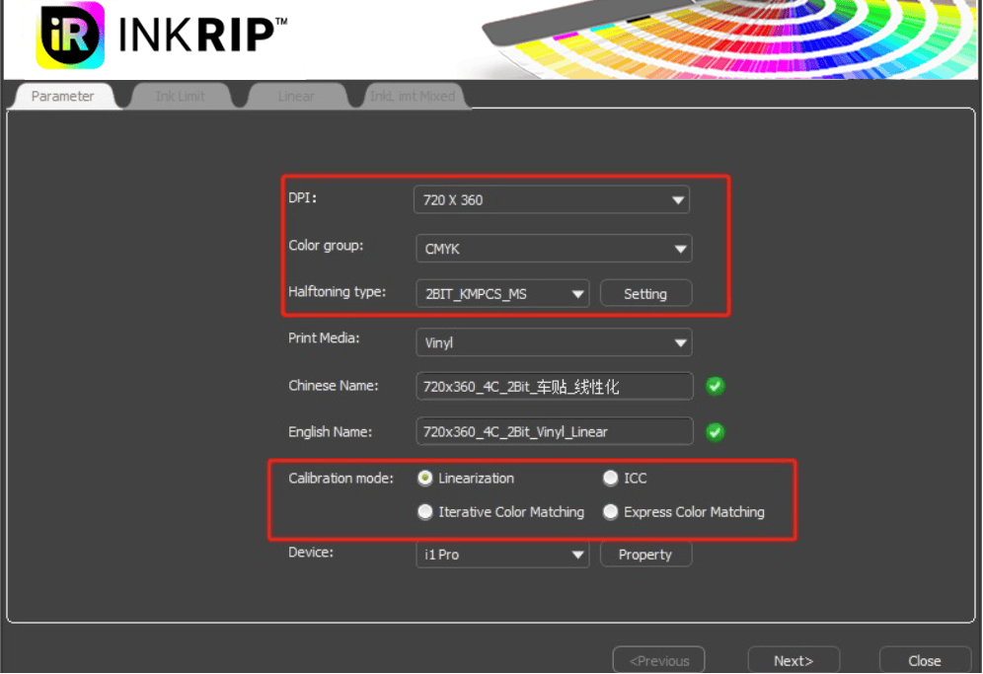
Sharp print curve production
2. New curve (parameter setting)
Where the actual impact curve effect of the parameters is set as follows:
Accuracy mode: the actual accuracy of the curve being printed
Color mode: the default setting is 4-color KCMY color sequence. In case of other multiple-color situations, it should be added and modified according to the actual color sequence
Calibration method: select and make the curve according to the customer's needs
Linearization: print ink color, do not participate in other colors (mostly used by textile customers)
ICC: print and restore the screen color (mostly advertising, a few textile customers use)
Closed-loop color chase: Use the color chase target with an icc
Speed color chase: used when the color chase target is linearized

Slide 4
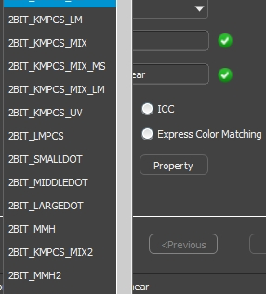
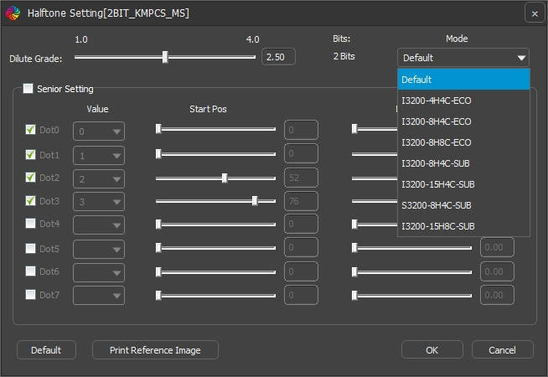
Sharp print curve production
1.1.1 Introduction of outlets
Type: variable and variable points (commonly known as 1bit, 2bit) 1 BIT _ DITHER: pure large for variable point nozzle (printer, etc.) 2 BIT _ LMPCS: The point type is fine, but the ink is relatively picked, and the transition is not easy to adjust (the transition problem can be optimized by closing the midpoint with parameter setting)
2 BIT _ KMPCS _ UV: uniform color block, rich printing color, smooth transition (often used in 8-color light black scheme)
2 BIT _ MMH: used for multi-nozzle use, fine print, suitable for most inks (the parameter set can close the midpoint to make it more delicate)
2 BIT _ MMH (D5) _ MIX: applied to multiple nozzle, uniform color distribution relative to mmh (significant improvement for feather channel, but thicker compared to mmh dot)
Note: Using mmH series outlets, you must click on the parameter to set and select the mode, otherwise the effect is not effective (if the mode is not selected, there will be a prompt)

Slide 5
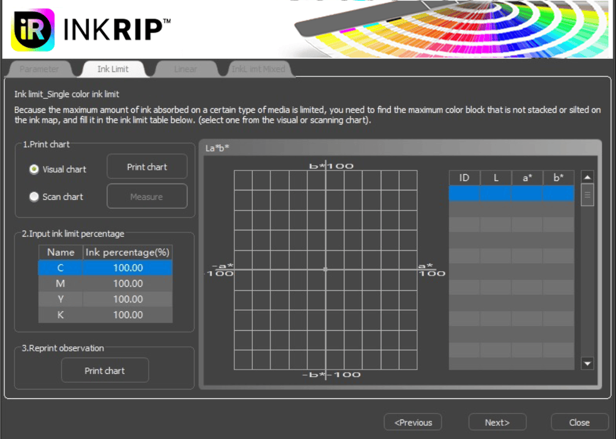
Sharp print curve production
Lineearized curve fabrication
1. Single ink volume interception: print on the medium to absorb the maximum amount of ink
At present, sharp printing is divided into two types of printing chart (visual chart, scanning chart), visual chart needs to be ink according to the printed material on the ink and the transition situation, and scanning chart requires equipment to realize automatic ink interception (the software will automatically generate lab according to the scanned data for viewing)

Slide 6
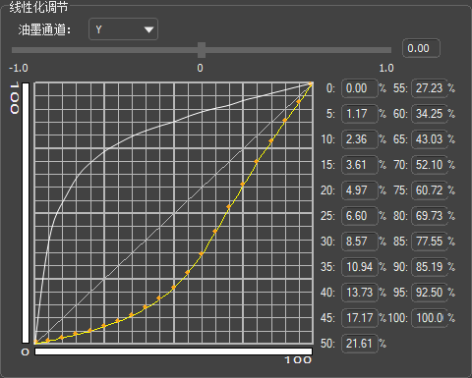
Sharp print curve production
Lineearized curve fabrication
2. Linearization: control the linear output of monochrome ink quantity (transition)
After printing the scanning chart, scan with the equipment: according to cmyk, from shallow to deep, slow and uniform scan, after the scan, the linear curve to ensure the transition is peaceful, without the kind of precipitous steep drop as normal.

Slide 7
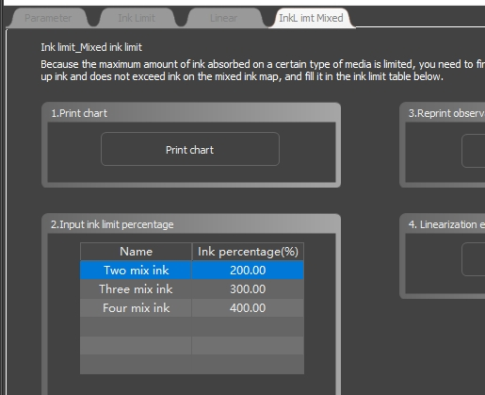
Sharp print curve production
Lineearized curve fabrication
3. Multiple ink volume:
If the monochrome ink cutting is the same, it is necessary to check its performance in the material for ink cutting (ink, transition)
At present, the four-color ink adopts a new algorithm, k100 remains motionless, through the increase of cmy to ensure that the four-color black printing is not green

Slide 8
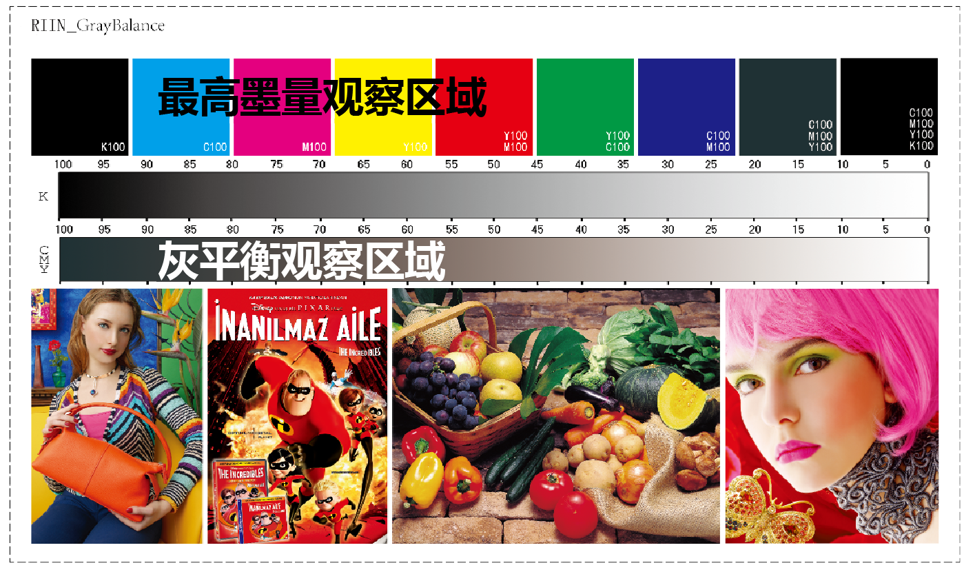
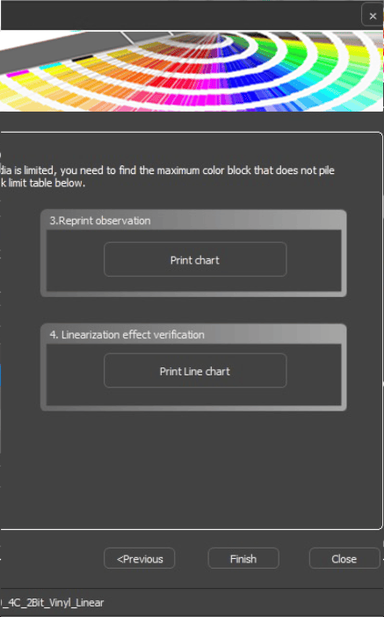
Sharp print curve production
Lineearized curve fabrication
4. Linearized test diagram:
Cut after need to print the linearized test chart, through the chart can view to the highest ink, gray balance transition, and color picture, take the bag of the female seam and pumpkin details if not out, said three color, four color cut ink is too little need more, if the white said ink too much.
Note: It can be adjusted through color management to achieve the desired effect

Slide 9
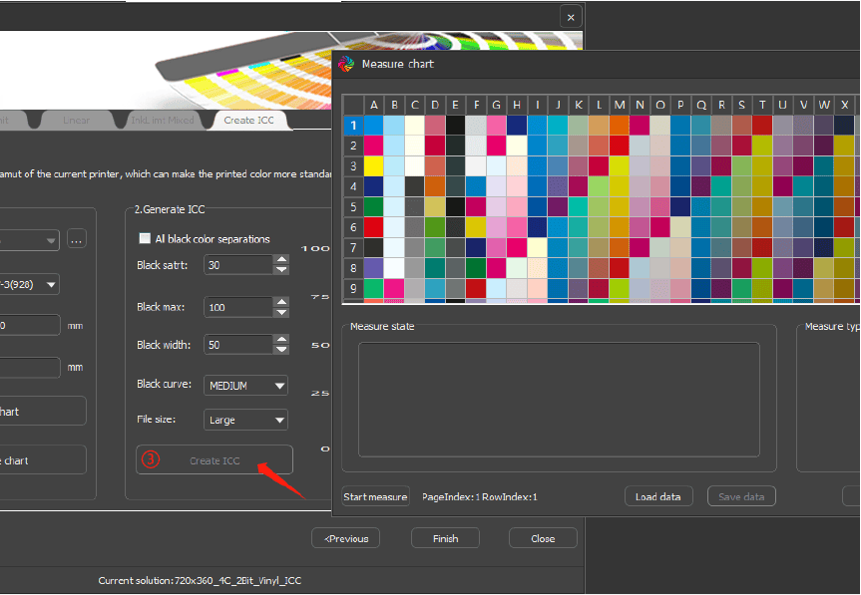
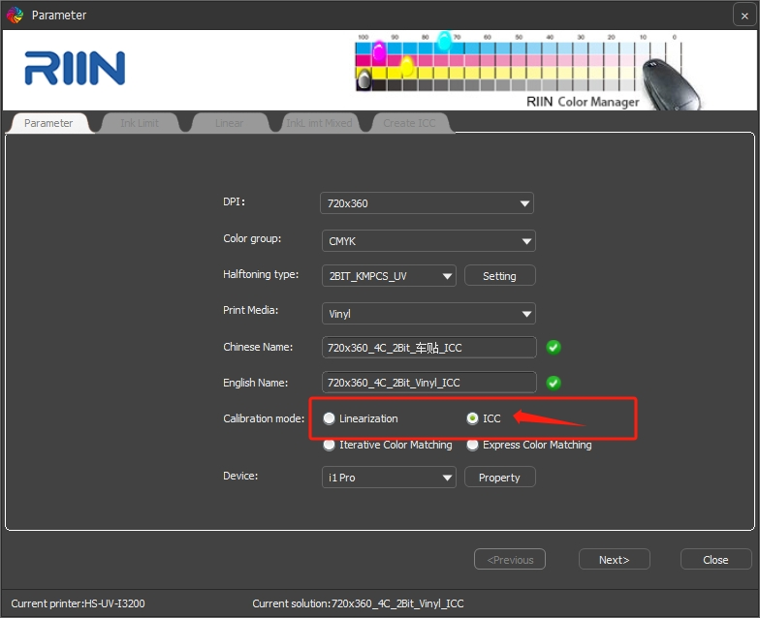
Sharp print curve production
1.2 ICC curve fabrication
At present, Ruiyin supports self-research of ICC production, and there are two production methods:
1. When making the curve, ICC is selected in the calibration method, and the linearized steps
① Select the chart style (default 8.7-3), you can select the canvas width and other settings according to the field situation, and print the chart
② Measure the chart. After clicking on the start measurement, the chart needs to be placed forward and can be scanned from left to right
③ Create ICC, click confirm after scanning, and click create ICC.

Slide 10
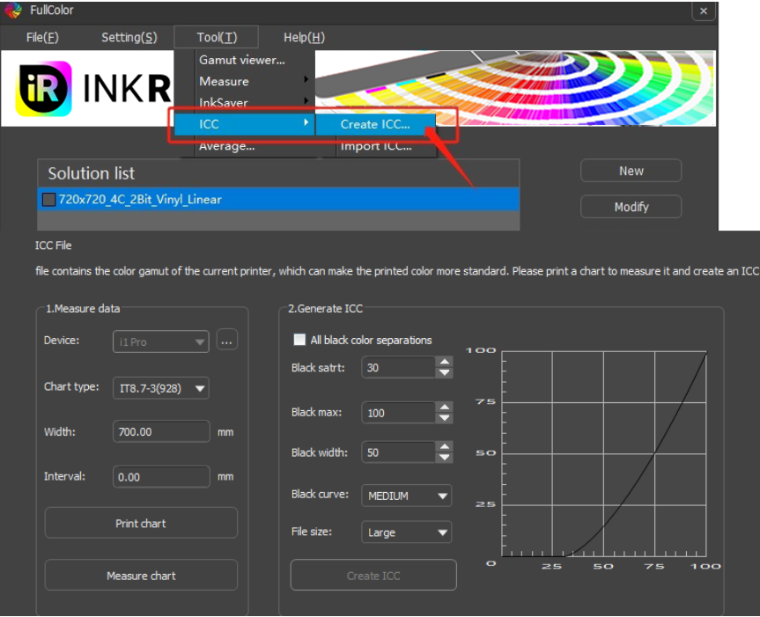
Sharp print curve production
2. Select the required curve to make icc in the color management interface, click the tool button, select ICC, click Create ICC, follow the above steps to make icc (see chapter 12 for details) and select icc print.
3. You can scan the color table in the third-party software (i1profiler), and select the import ICC in the tool

Slide 11
Sharp print curve production
Thank you！

